Slide 1


Mountain Bike Suspension​ 20FB14
Erik Abraham, Suliman Alsinan, Jacob Cryder
Austin Coyne, Dylan Klemp, Tyson Spencer
Erik

Slide 2

Problem Statement
Mountain bike suspension lacks the capabilities to quickly and easily adjust for different terrain on the fly and needs to have a tuning option to allow for a more comprehensive system. Mountain bike suspension can be adjusted but can sometimes be difficult to understand for the average consumer. So, the team needs to create an easier way to help even beginner mountain bikers be able to alter their suspension settings.

Slide 3
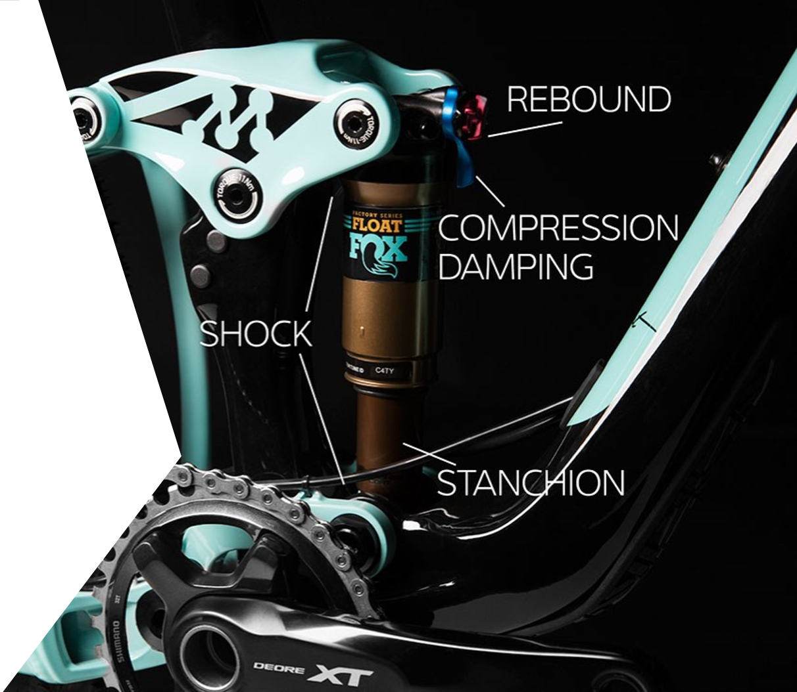

INTRODUCTION
Create a mathematical model to optimize damping in full suspension mountain bikes over various terrains​
Analyze mathematical model with physical testing of a shock and mountain bike​
Develop an easy to use, suspension tuning device that allows for mountain bikers to adjust their suspension on the trail
Erik

Slide 4
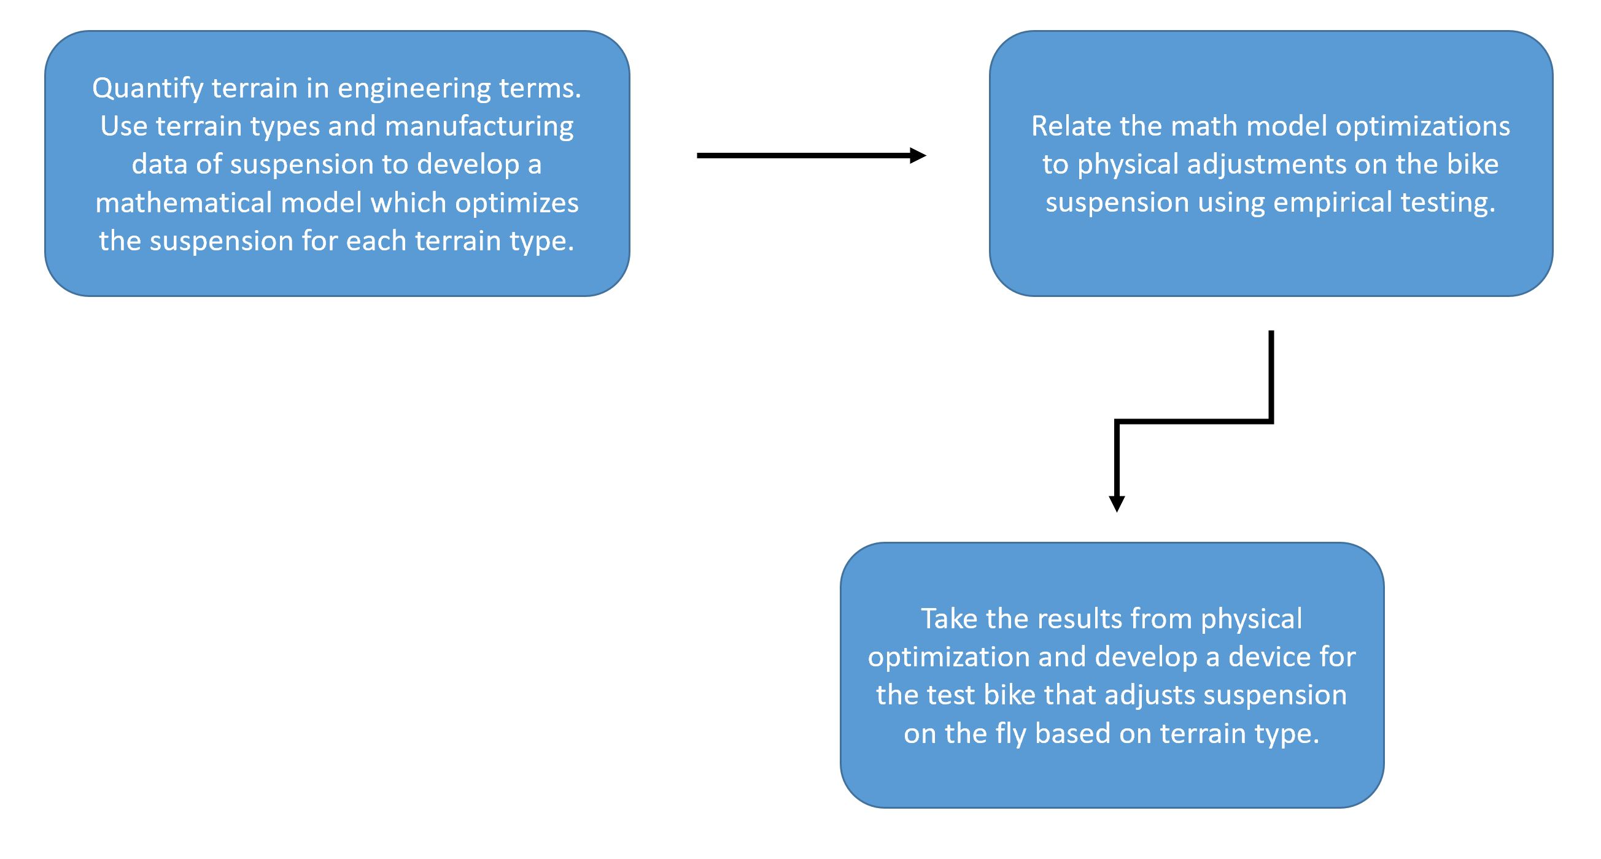
PROJECT BREAKDOWN
Erik

Slide 5
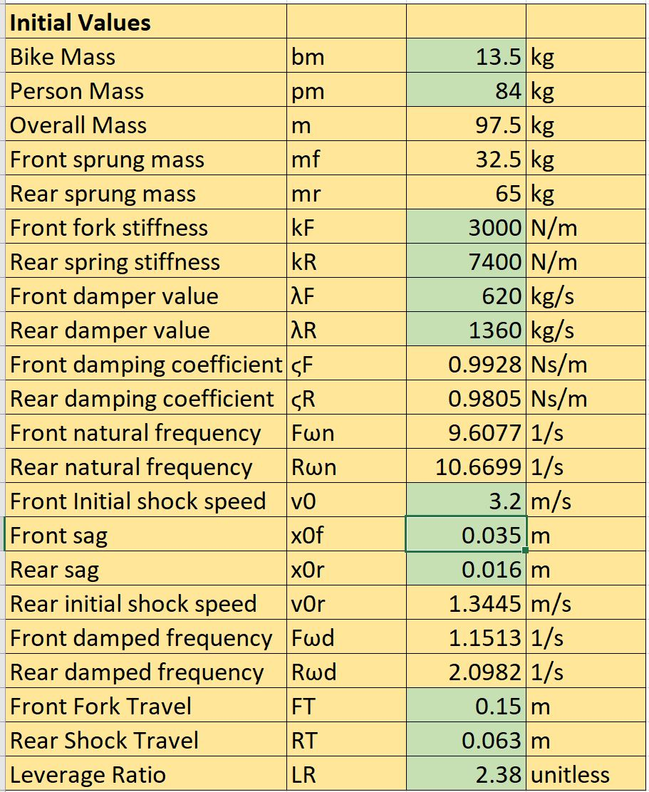
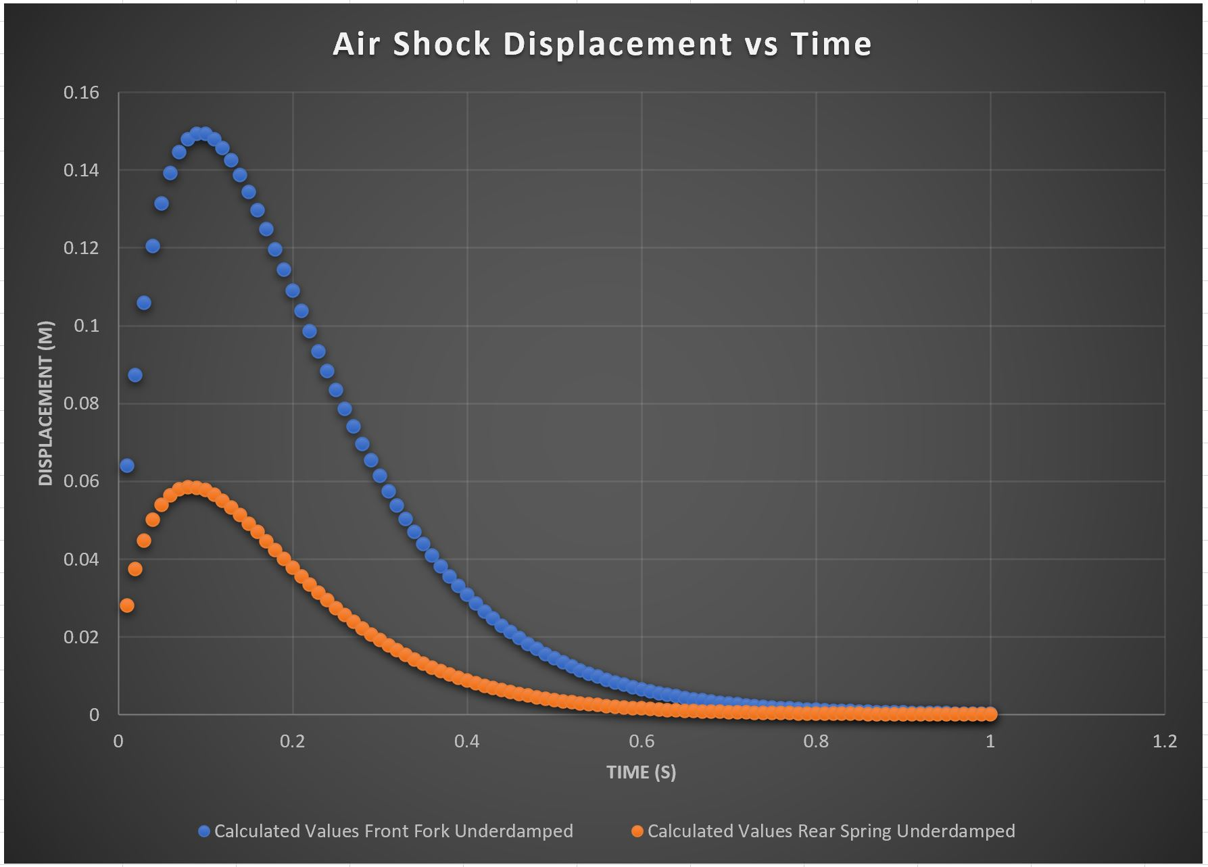
MATHEMATICAL MODEL
Math Model Inputs and Outputs [2]
Tyson

Slide 6

EQUATIONS DRIVING MATHEMATICAL MODEL
For Critically Damped: ϛ = 1
$$x\left(t\right)=\left[x_{0}+\left(v_{0}+ω_{n}x_{0}\right)t\right]e^{−ω_{n}t}$$
For Slightly Underdamped: ϛ < 1
$$x\left(t\right)=e^{−{ϛω}_{n}t}[x_{0}cosω_{d}t+\frac{v_{0}+{ϛω}_{n}x_{0}}{ω_{d}}sinω_{d}t]$$
where
$$ω_{d}=ω_{n}\sqrt{1−ϛ^{2}}$$
[3]
Tyson

Slide 7

CUSTOMER AND ENGINEERING REQUIREMENTS
Customer Requirements
Engineering Requirements
Base research on current mathematical models
Extensive research on bike suspension system
Ensure the average user can utilize design
Incorporate Solid Works and Excel Code
Validation Testing
Spring and damping rate critical/underdamped for all cases (lbfs/in)
Validate mathematical model with other testing (%diff)
Compatible with test bike (mm)
Minimize weight addition (g)
Compact design to fit on handlebars (cm^2)
Durability (MPa)
Dylan

Slide 8
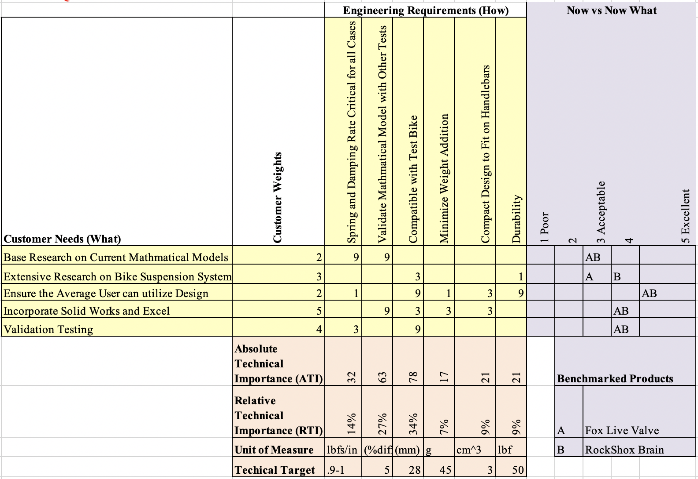
HOUSE OF QUALITY
Dylan

Slide 9
DESIGN VALIDATION
Inputs: Types of routes, rider’s size, and shock specification
Outputs: adjustment that you should apply
Validate the data with actual testing
Suliman

Slide 10
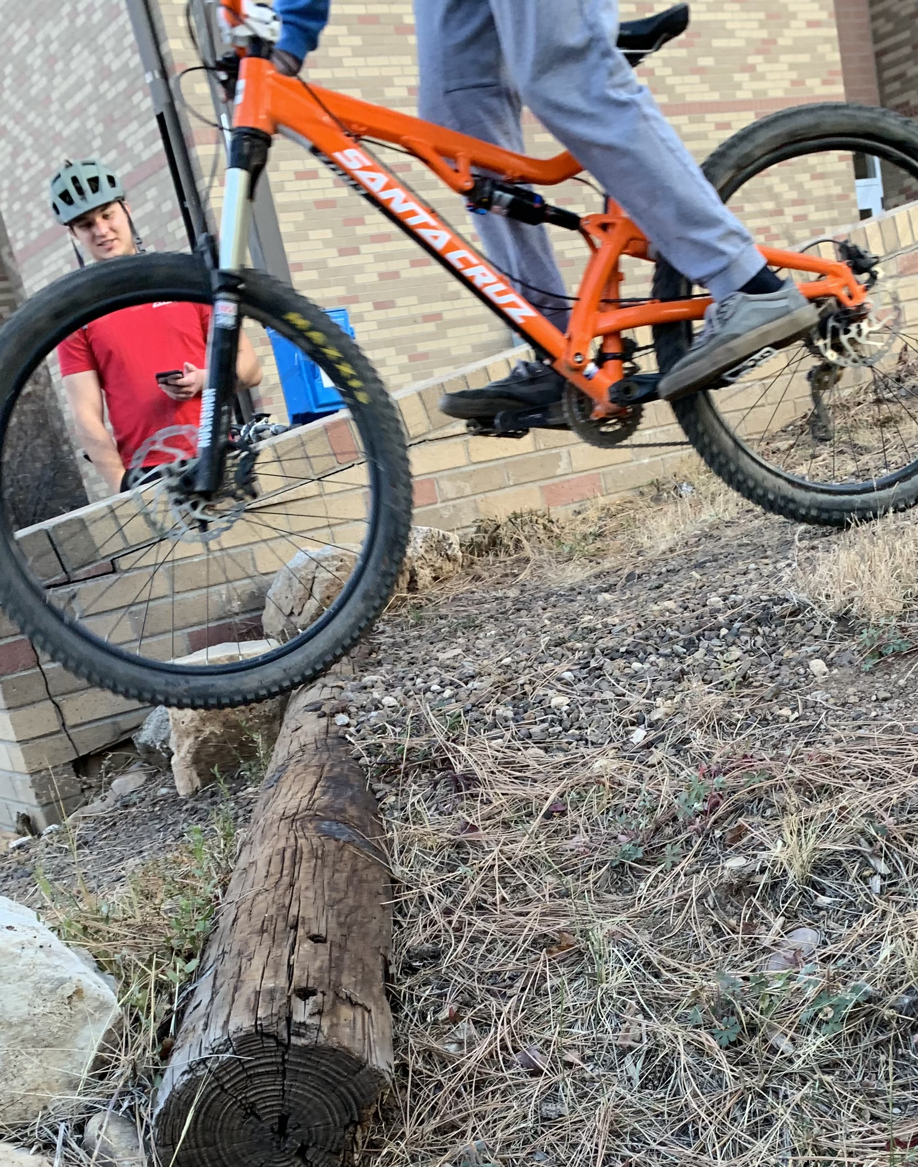
TESTING PROCEDURES
Testing Procedure 1: Sag Test
Required for the mathematical model
Measurement of the ”Sag” or initial suspension displacement
Testing Procedure 2: Dynamic Model Validation
Will be used to test the validity of the mathematical model
Very important considering our mathematical model is static
An Arduino will be used to measure displacement over time
Testing Procedure 3: Device Testing
Testing will be done on our device to make sure it works and produces the correct results
Austin

Slide 11
PROJECT PLAN
Gantt Chart
Jacob

Slide 12
Sources
[1] Liv. https://www.liv-cycling.com/global/campaigns/how-to-set-up-mountain-bike-suspension/20654. Accessed: 18 September 2020​
[2] T. Spencer. “BikeMathModel.” Microsoft Excel. November 2020
[3] School of Engineering, Brown University. “Introduction to Dynamics and Vibrations.” ​https://www.brown.edu/Departments/Engineering/Courses/En4/Notes/vibrations_free_damped/vibrations_free_damped.htm. Accessed: October 2020

